Slide 1
Lesson 5:
Dairy
Notes:
Hi everyone! My name is ___________
Today we are going to talk about dairy foods and drinks. Dairy foods are foods that are made from milk, which as we all know, comes from cows. Dairy foods play an important role in keeping our bones healthy and strong.
We are going to learn a lot more about that in a little while. But let’s review a few other things first.

Slide 2
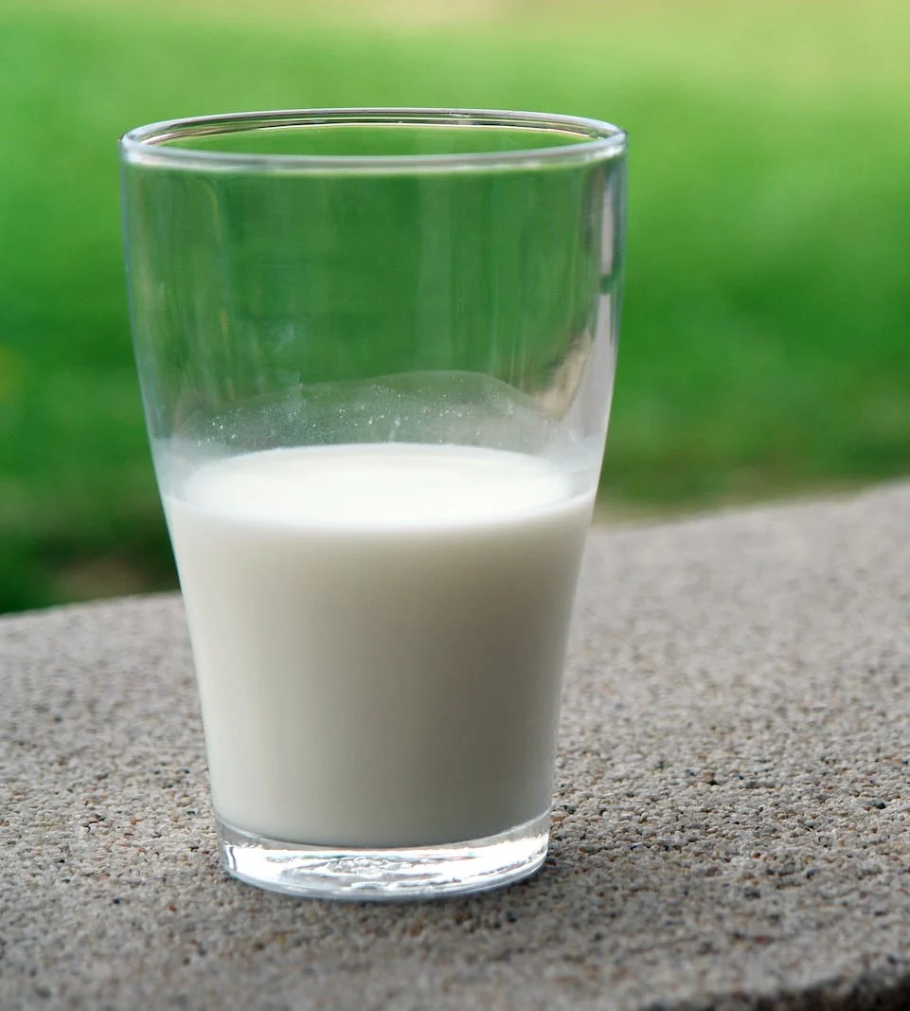
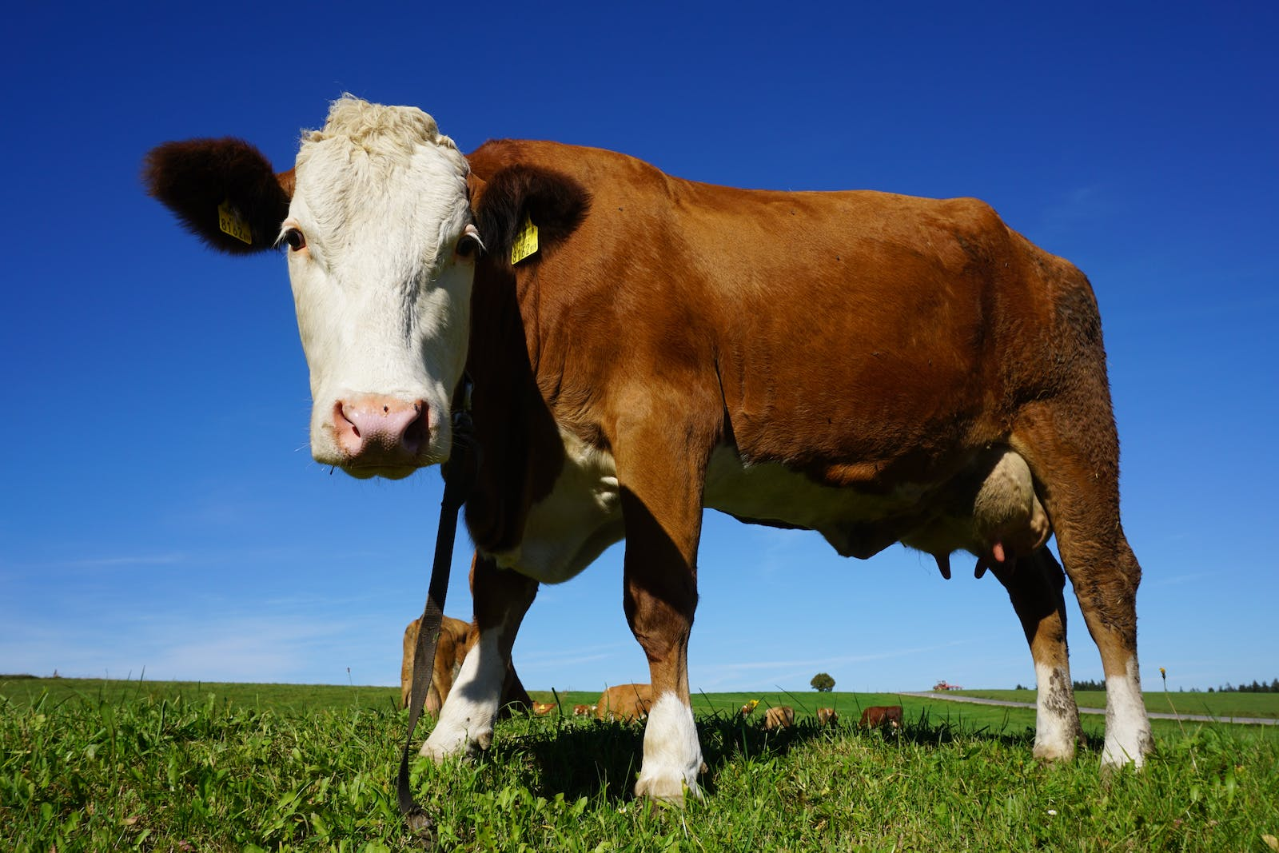
TODAY'S
SCHEDULE
Review of Fiber Foods
Intro to Dairy
Video Lesson
Cooking Activity: Yogurt Parfaits!
Notes:
Here is our schedule for the day. First, we are going to review what we learned in our last class about Fiber foods.
Then, we will learn about dairy foods and drinks.
Then, we will watch a video all about dairy and why it is important to get enough dairy foods & drinks.
Finally, we will do a fun cooking activity in where we will make a snack with yogurt, which is a dairy food.

Slide 3
Class Rules
Listening Ears
Quiet Mouths
Follow Instructions
Don't Yuck My Yum !
Notes:
Before we begin, let’s go over our rules, which are the same as last time. But it always helps to remind ourselves about these important rules.

Slide 4
Let’s review from our last class!
Who can raise their hand and tell me:
Fiber is the part of _____ foods that our bodies do not digest.
Plant
________ occurs when our bodies break down foods into tiny parts
Digestion
In which parts of our bodies does digestion occur?
In our stomach and intestines

Slide 5
Who can raise their hand and tell me:
Fiber also helps our _______ stay healthy and strong.
Hearts
Fiber and _______ work together to keep our bodies clean.
Water
Some examples of plant foods that have lots of fiber are______.
Raspberries, apples, pears, broccoli, whole wheat bread, oatmeal, peas, brown rice
Notes:
For the last question, basically any fruit or vegetable would be an acceptable answer. Also any whole grain food.

Slide 6
OK, let’s learn about Dairy!
Notes:
Now, we are going to learn all about dairy foods and drinks, and the important role that dairy plays in keeping our bodies healthy. Let’s watch and learn!

Slide 7
One More Thing!
If you don’t eat dairy, you can still get enough calcium!
Look for foods fortified with calcium, such as:
Soy milk
Almond milk
Oat milk
Soy yogurt
Coconut yogurt
Orange juice
…and more!
Make sure the label of the food or drink says that it contains calcium!
Notes:
Maybe you have an allergy to dairy, or don’t eat & drink dairy for some other reason. That is OK!

Slide 8
Let’s Review
Who can raise their hand and tell me:
The name of the nutrient found in dairy foods that helps to keep our bones strong & healthy?
Calcium
Dairy foods are foods made from ______
Milk (from cows)
Some examples of dairy foods include:
Milk
Yogurt
Cheese
Ice cream
Pudding
To get enough calcium to keep our bones healthy & strong, we need to eat ___ servings of dairy every day.
Three (3)

Slide 9
OK, now let’s cook!
What is the first thing we do before we touch food or start cooking?
Wash our hands!!
Notes:
Apply hand sanitizer to all students’ OR have them wash hands if that is a feasible option.

