Slide 1
Lesson 4:
Fiber
Notes:
Hi everyone! My name is ___________
Today we are going to talk about fiber. Fiber is found in plant foods, and is a super important nutrient that keeps our bodies clean and our hearts healthy. And most people do not eat enough fiber, which is why we want you to learn all about how important it is.
We are going to learn a lot more about that in a little while. But let’s review a few other things first.

Slide 2
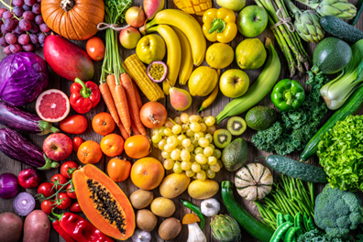
TODAY'S
SCHEDULE
Review of Parts of a Plant
Intro to Fiber
Video Lesson
Cooking Activity: Fiber-full trail mix!
Notes:
Here is our schedule for the day. First, we are going to review what we learned in our last class about Parts of a Plant.
Then, we will learn about fiber in our food.
Then, we will watch a video all about plant parts that we eat as food.
Finally, we will do a fun cooking activity in where we will make a snack that is full of fiber.

Slide 3
Class Rules
Listening Ears
Quiet Mouths
Follow Instructions
Don't Yuck My Yum !
Notes:
Before we begin, let’s go over our rules, which are the same as last time. But it always helps to remind ourselves about these important rules.

Slide 4
Parts of a Plant Review
Who can raise their hand and tell me:
The 5 parts of plants that we eat?
Root
Stem
Leaves
Flower
Fruit
Notes:
Good job naming all the plant parts!

Slide 5
Now, who can raise their hand and tell me an example of a:
Root
Carrot, potato, onion, sweet potato
Stem
Celery, Asparagus
Leaf
Spinach, lettuce, cabbage, collard greens, kale

Slide 6
Now, who can raise their hand and tell me an example of a:
Flower
Broccoli, cauliflower, artichoke
Fruit
Apples, strawberry, pear, tomato, cucumber
Notes:
Note: they may say lots of other examples of fruits since this is probably the most well-known one with lots of examples. These are just a few.

Slide 7
OK, let’s get started!
Notes:
Now, we are going to learn all about fiber foods, and the important role that fiber plays in keeping our bodies healthy. Let’s watch and learn!

Slide 8
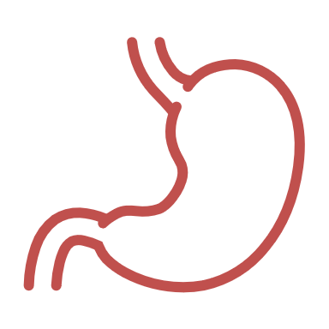
OK, let’s review!
Who can raise their hand and tell me:
Fiber is the part of _____ foods that our bodies do not digest.
Plant
________ occurs when our bodies break down foods into tiny parts
Digestion
In which parts of our bodies does digestion occur?
In our stomach and intestines

Slide 9
OK, let’s review!
Who can raise their hand and tell me:
Fiber also helps our _______ stay healthy and strong.
Hearts
Fiber and _______ work together to keep our bodies clean.
Water
Some examples of plant foods that have lots of fiber are______.
Raspberries, apples, pears, broccoli, whole wheat bread, oatmeal, peas, brown rice
Notes:
For the last question, basically any fruit or vegetable would be an acceptable answer. Also any whole grain food.

Slide 10
OK, now let’s cook!
What is the first thing we do before we touch food or start cooking?
Wash our hands!!
Notes:
Apply hand sanitizer to all students’ OR have them wash hands if that is a feasible option.

