Slide 1
Lesson 3:
Parts of a Plant
Notes:
Hi everyone! My name is ___________
Today we are going to talk about the parts of plants that we eat. Did you know that lots of foods that we eat are actually parts of lots of different plants? Like lettuce, which is a leaf!
We are going to learn a lot more about that in a little while. But let’s review a few other things first.

Slide 2
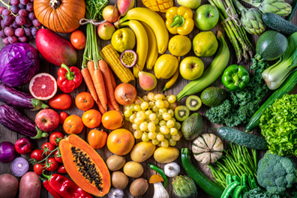
TODAY'S
SCHEDULE
Review of Eating a Rainbow
Intro to Parts of a Plant
Video Lesson
Cooking Activity: Create and Eat a Whole Plant!
Notes:
Here is our schedule for the day. First, we are going to review what we learned in our last class about Eating the Rainbow.
Then, we will learn about the parts of a plant that we eat.
Then, we will watch a video all about plant parts that we eat as food.
Finally, we will do a fun cooking activity in where we will create a whole plant out of foods AND get to eat it!

Slide 3
Class Rules
Listening Ears
Quiet Mouths
Follow Instructions
Don't Yuck My Yum !
Notes:
Before we begin, let’s go over our rules, which are the same as last time. But it always helps to remind ourselves about these important rules.

Slide 4
Review: Eat the Rainbow
Notes:
Before we get to our lesson for today, let’s see what you can remember from our last time together, when we learned about eating the rainbow.

Slide 5
Review: Eat the Rainbow & Nutrients
Nutrients
Red:
Notes:
Who can raise their hand and tell me what RED foods do for our bodies?

Slide 6
Review: Eat the Rainbow & Nutrients
Nutrients
Red: Heart & Fight Disease
Orange:
Notes:
Who can raise their hand and tell me what ORANGE foods do for our bodies?

Slide 7
Review: Eat the Rainbow & Nutrients
Nutrients
Red: Heart & Fight Disease
Orange: Eyes & Fight Germs
Yellow:
Notes:
Who can raise their hand and tell me what YELLOW foods do for our bodies?

Slide 8
Review: Eat the Rainbow & Nutrients
Nutrients
Red: Heart & Fight Disease
Orange: Eyes & Fight Germs
Yellow: Heal Repair Skin
Green:
Notes:
Who can raise their hand and tell me what GREEN foods do for our bodies?

Slide 9
Review: Eat the Rainbow & Nutrients
Nutrients
Red: Heart & Fight Disease
Orange: Eyes & Fight Germs
Yellow: Heal Repair Skin
Green: Strong Bones & Muscles Blue:
Notes:
Who can raise their hand and tell me what BLUE foods do for our bodies?

Slide 10
Review: Eat the Rainbow & Nutrients
Nutrients
Red: Heart & Fight Disease
Orange: Eyes & Fight Germs
Yellow: Heal Repair Skin
Green: Strong Bones & Muscles Blue: Brain Power & Memory
Purple:
Notes:
Who can raise their hand and tell me what PURPLE foods do for our bodies?

Slide 11
Review: Eat the Rainbow & Nutrients
Nutrients
Red: Heart & Fight Disease
Orange: Eyes & Fight Germs
Yellow: Heal Repair Skin
Green: Strong Bones & Muscles Blue: Brain Power & Memory
Purple: Tummies for Digestion
Notes:
Great job, everyone. So as we can see here, when we eat fruits & vegetables of all different colors, we are making sure that we are helping our bodies stay healthy & strong in so many ways.

Slide 12
OK, let’s get started!
Notes:
Now, Ms. Sara is going to teach us all about the parts of a plant that we eat. Let’s watch and learn!

Slide 13
Now Let’s Review!
Who can raise their hand and tell me:
The 5 parts of plants that we eat?
Root
Stem
Leaves
Flower
Fruit
Notes:
Good job naming all the plant parts!

Slide 14
Now, who can raise their hand and tell me an example of a:
Root
Carrot, potato, onion, sweet potato
Stem
Celery, Asparagus
Leaf
Spinach, lettuce, cabbage, collard greens, kale
Flower
Broccoli, cauliflower, artichoke
Fruit
Apples, strawberry, pear, tomato, cucumber
Notes:
Note: they may say lots of other examples of fruits since this is probably the most well-known one with lots of examples. These are just a few.

Slide 15
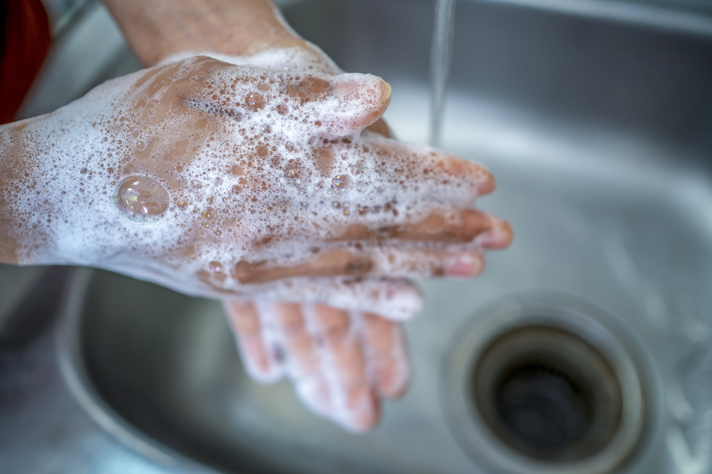
OK, now let’s cook!
What is the first thing we do before we touch food or start cooking?
Wash our hands!!
Notes:
Apply hand sanitizer to all students’ OR have them wash hands if that is a feasible option.

