Slide 1
Lesson 6:
Hydration
Notes:
Hi everyone! My name is ___________
Today we are going to talk about hydration. Maybe that’s a new word for you. It means making sure your body is balancing the water that comes in with the water that goes out. A big part of staying hydrated is drinking enough water.
We are going to learn a lot more about that in a little while. But let’s review a few other things first.

Slide 2
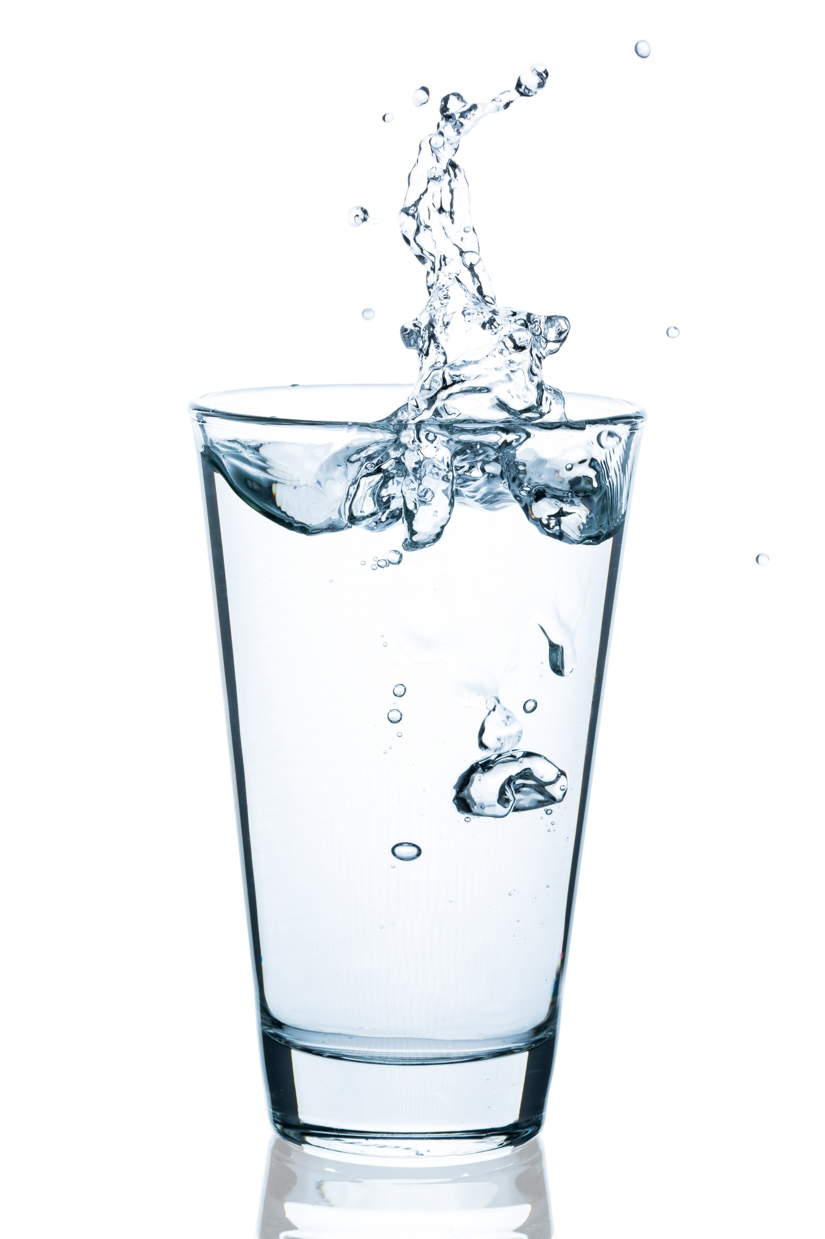
TODAY'S
SCHEDULE
Review of Dairy Foods & Drinks
Intro to Hydration
Video Lesson
Cooking Activity: Hydration Drink!
Notes:
Here is our schedule for the day. First, we are going to review what we learned in our last class about Dairy foods and drinks.
Then, we will learn about hydration.
Then, we will watch a video all about hydration and why it is important to get make sure your bodies stay hydrated.
Finally, we will do a fun cooking activity in where we will make a hydrating beverage.

Slide 3
Class Rules
Listening Ears
Quiet Mouths
Follow Instructions
Don't Yuck My Yum !
Notes:
Before we begin, let’s go over our rules, which are the same as last time. But it always helps to remind ourselves about these important rules.

Slide 4
Let’s Review: Dairy
Who can raise their hand and tell me:
The name of the nutrient found in dairy foods that helps to keep our bones strong & healthy?
Calcium
Dairy foods are foods made from ______
Milk (from cows)
Some examples of dairy foods include:
Milk
Yogurt
Cheese
Ice cream
Pudding
To get enough calcium to keep our bones healthy & strong, we need ___ servings of dairy every day.
Three (3)

Slide 5
If you don’t eat dairy, you can still get enough calcium from foods that are fortified with _______ .
Calcium
A few examples of foods that may be with calcium are:
Soy milk
Almond milk
Oat milk
Soy yogurt
Coconut yogurt
Orange juice
…and more!
Remember: Make sure the label of the food or drink says that it contains calcium!
Notes:
Maybe you have an allergy to dairy, or don’t eat & drink dairy for some other reason. That is OK!

Slide 6
OK, let’s learn about Hydration!
Notes:
Now, we are going to learn all about hydration, and the important role that balancing water in our bodies plays in keeping us healthy and strong. Let’s watch and learn!

Slide 7
OK, now let’s review
Who can raise their hand and tell me:
How much (what percent) of our bodies is made up of water?
70%
Some important jobs that water does in our bodies include:
Bringing nutrients from our food to all the parts of our bodies that use them
Keeping our joints moving well
Keeping our body temperature from getting too hot
Helping flush out waste from our bodies
Our bodies lose water when we:
Go to the bathroom
Sweat
Breathe

Slide 8
Who can raise their hand and tell me:
Kids your age need to drink about __ glasses of water every day
8
Some examples of foods that contain a lot of water is:
Watermelon
Cucumbers
Oranges
One way to check whether you are well-hydrated is to check the color of your:
Pee!

Slide 9
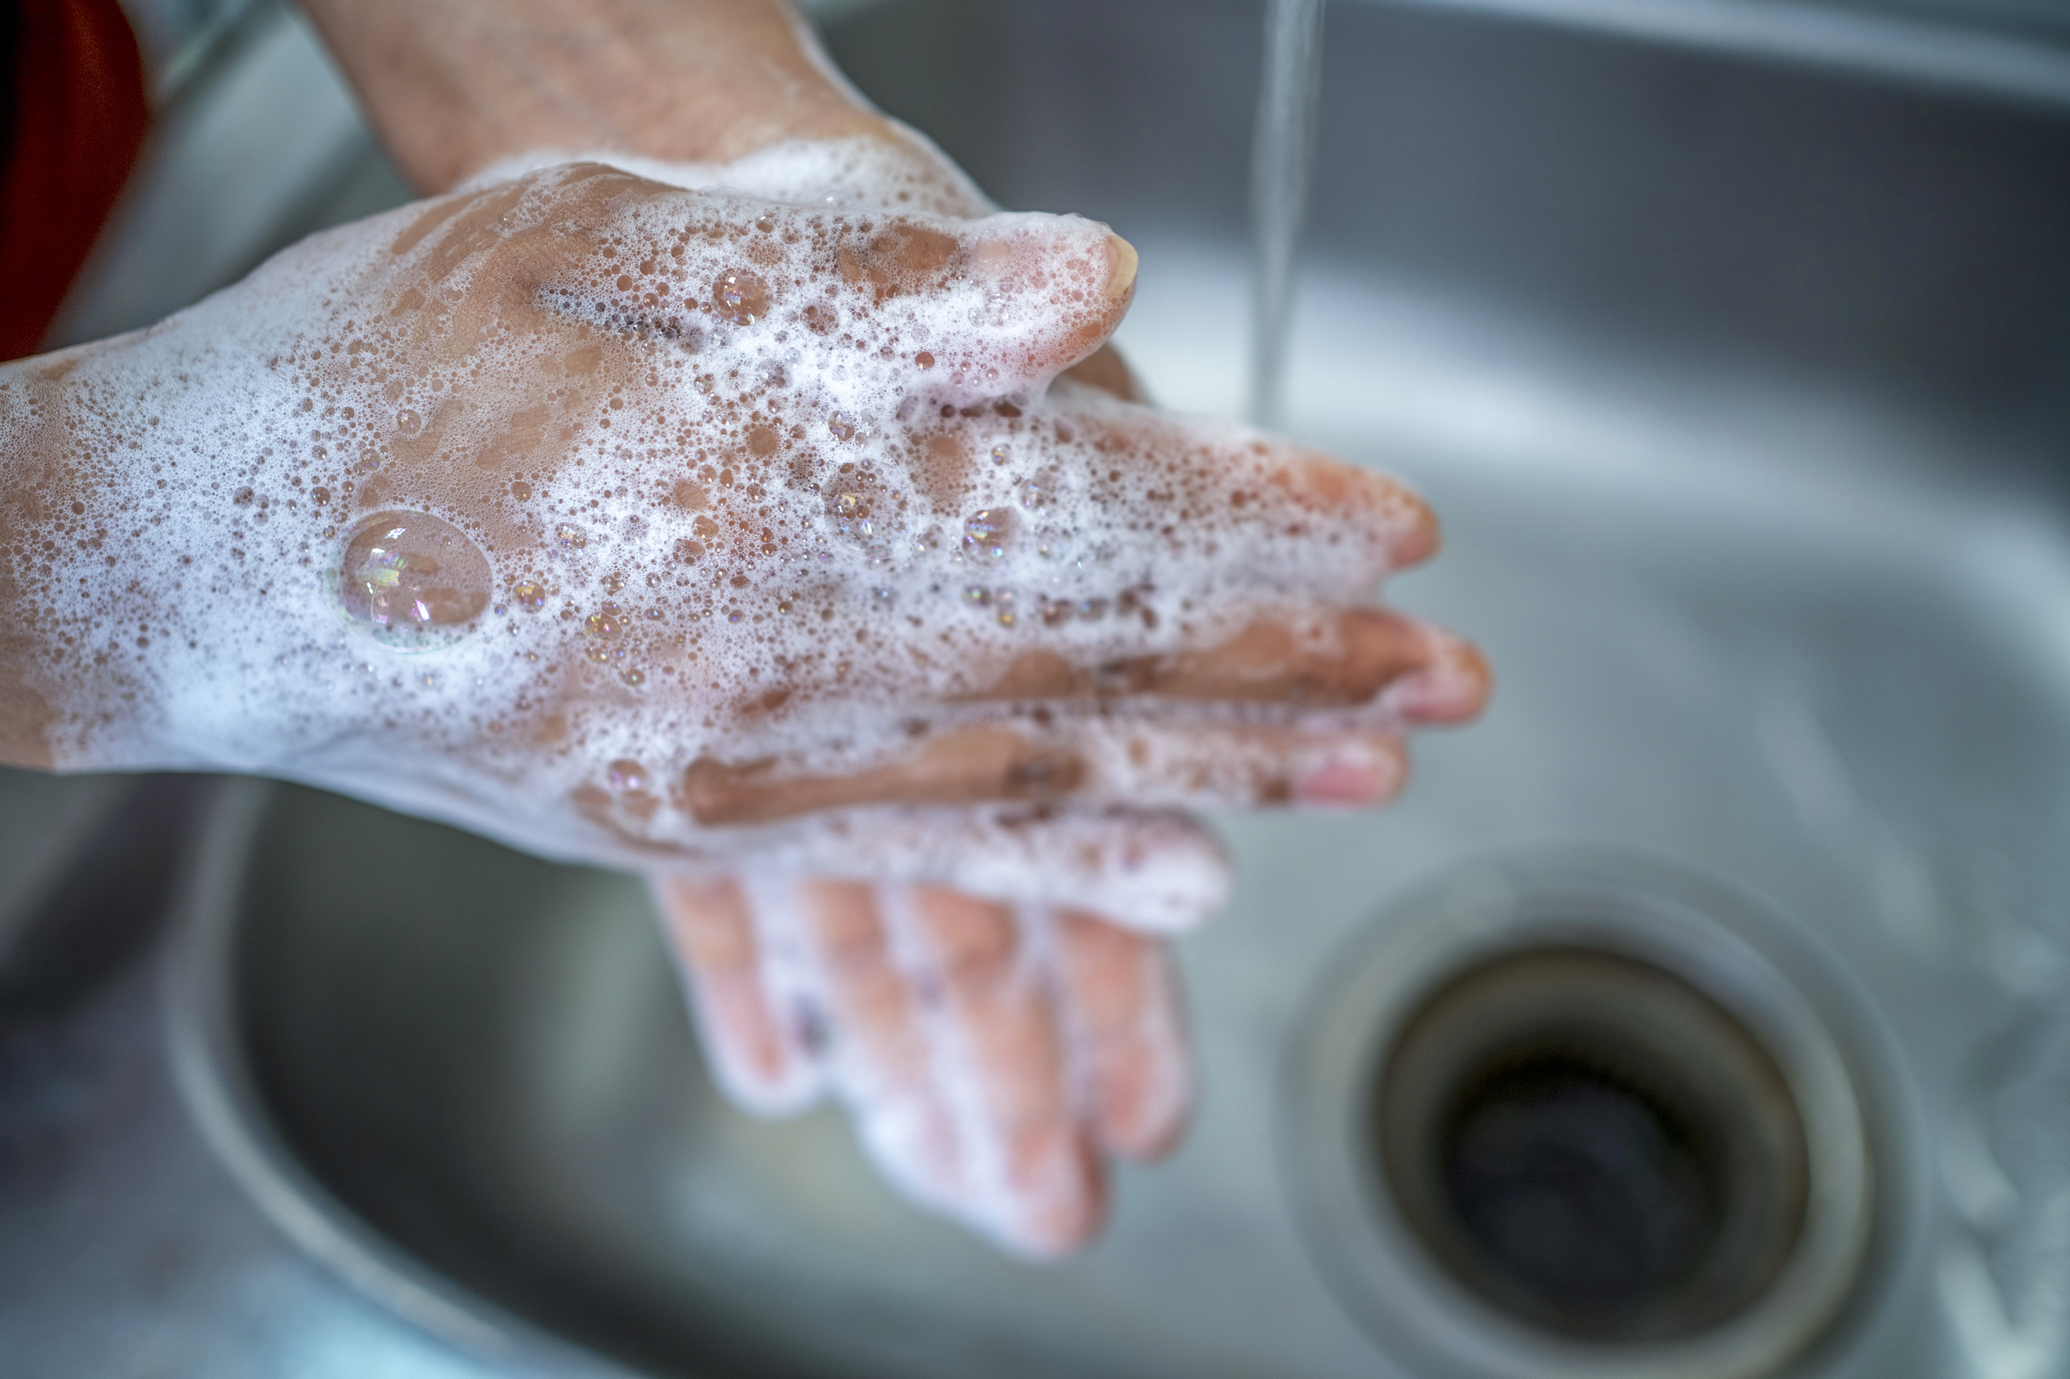
OK, now let’s cook!
What is the first thing we do before we touch food or start cooking?
Wash our hands!!
Notes:
Apply hand sanitizer to all students’ OR have them wash hands if that is a feasible option.

