Slide 1
Lesson 2:
Eat the Rainbow
Notes:
Hi everyone! My name is ___________
Today we are going to talk about eating the rainbow. Of course I don’t mean an actual rainbow, but a rainbow of foods. We will learn more about what that means during today’s class.

Slide 2
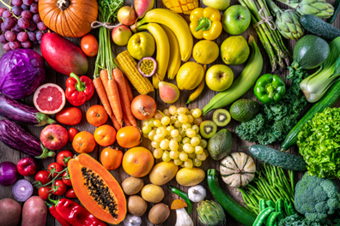
TODAY'S
SCHEDULE
Review of MyPlate
Intro to ”Eating the Rainbow"
Video Lesson
Cooking Activity: Create and Eat a Rainbow!
Notes:
Here is our schedule for the day. First, we are going to review what we learned in our last class about MyPlate and nutrients.
Then, we will learn what it means to eat a rainbow and why it is important to keep our bodies healthy and strong.
Then, we will watch a video all about eating the rainbow.
Finally, we will do a fun cooking activity in where we will create a rainbow out of foods AND get to eat it!

Slide 3
Class Rules
Listening Ears
Quiet Mouths
Follow Instructions
Don't Yuck My Yum !
Notes:
Before we begin, let’s go over our rules, which are the same as last time. But it always helps to remind ourselves about these important rules.

Slide 4
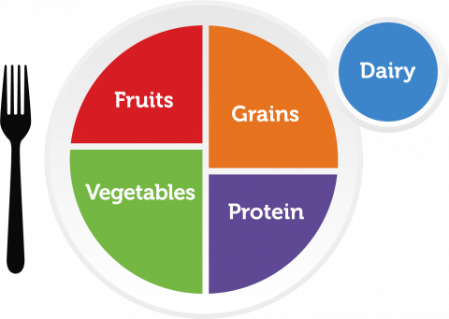
Review: Nutrition & My Plate
Notes:
OK, let’s get started! Who can raise their hand and tell me the name of this thing here? (MyPlate)
We learned last time that MyPlate shows us the 5 food groups that we need to eat to help our bodies grow healthy and strong. So let’s remind ourselves what those food groups are.

Slide 5
Review: Nutrition & My Plate
Notes:
First, we have the fruit group in red.

Slide 6
Review: Nutrition & My Plate
Notes:
Vegetable group in green

Slide 7
Review: Nutrition & My Plate
Notes:
The grain group is orange

Slide 8
Review: Nutrition & My Plate
Notes:
Protein is purple.

Slide 9
Review: Nutrition & My Plate
Notes:
And finally, Dairy is in blue. Now MyPlate is complete!
And we know that each of these food groups contains different nutrients that our bodies need to stay healthy and strong, which is why we want to try to eat foods from all 5 groups every day.

Slide 10
OK, let’s get started!
Notes:
Now, Ms. Sara is going to teach us all how to eat the Rainbow!

Slide 11
Now Let’s Review!
Who can raise their hand and tell me:
Which color foods help your heart stay healthy?
RED
Which color foods help your eyes, and fights germs?
ORANGE
Which color foods help keep heal your skin?
YELLOW

Slide 12
Now Let’s Review!
Which color foods help keep your bones & muscles strong?
GREEN
Which color foods support your brain and memory?
BLUE
Which color foods help your tummy with digestion?
PURPLE

Slide 13
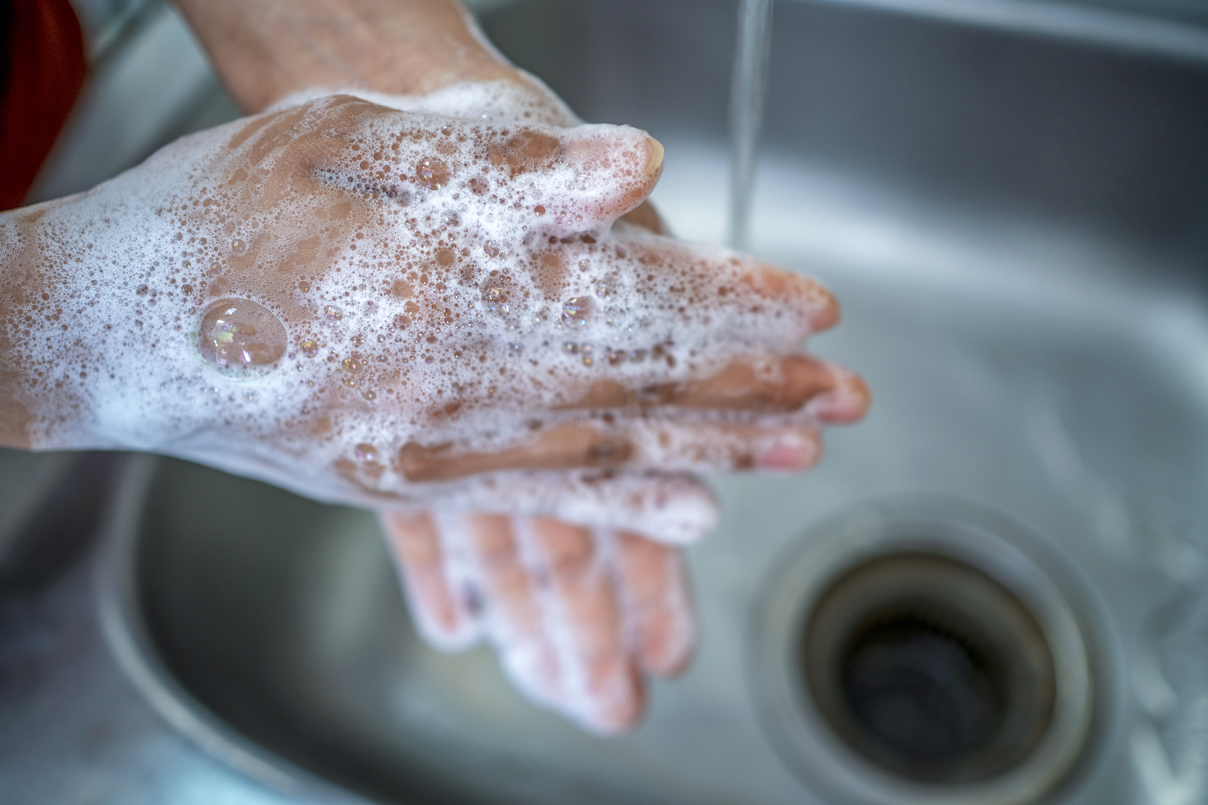
OK, now let’s cook!
What is the first thing we do before we touch food or start cooking?
Wash our hands!!
Notes:
Apply hand sanitizer to all students’ OR have them wash hands if that is a feasible option.

