Slide 1
Lesson 1:
Nutrients in our Food

Slide 2
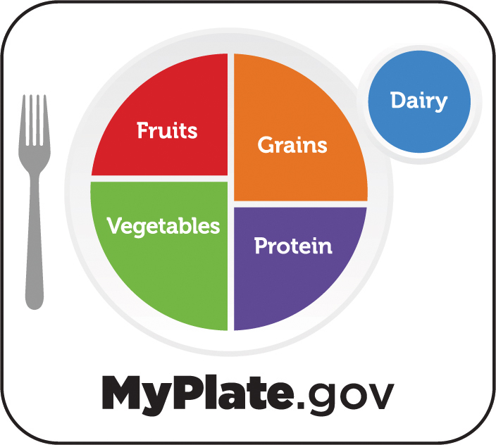
TODAY'S
SCHEDULE
Introductions
Watch video
Review what we learned
Cooking activity
Notes:
Hello everyone! My name is __________
Today we are going to learn about something really important: NUTRIENTS in our food.
Before we get started, I want to review our agenda for today and go over a few rules.

Slide 3
Class Rules
Listening Ears
Quiet Mouths
Follow Instructions
Don't Yuck My Yum !

Slide 4
OK, let’s get started!

Slide 5
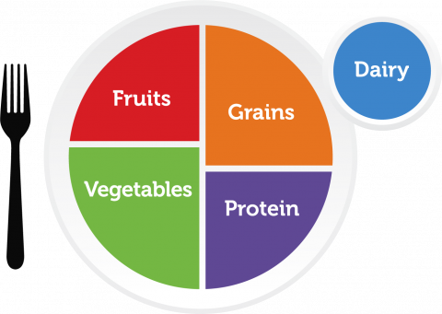
OK, let’s review!
Who can raise your hand and tell me:
The name for what is in our food that helps our bodies to grow healthy and strong?
The name of this, which helps us to know which foods to eat to make sure we are getting all the nutrients our bodies need?
True or False: our bodies can get all the nutrients they need if we eat foods only from the grain and dairy food groups.
Notes:
Correct response: Nutrients
(HOLD UP MYPLATE PAPER PLATE) – Correct response: MyPlate
Correct response: FALSE. We need to eat foods from ALL the food groups to get all the nutrients our bodies need.

Slide 6
OK, now let’s start our cooking activity
What is the first thing we do before we touch food or start cooking?
Wash our hands!!
Notes:
Apply hand sanitizer to all students’ OR have them wash hands if that is a feasible option.

Slide 7
MyPlate Snack Plate
Notes:
We are going to make a snack plate with foods form all 5 MyPlate food groups

Slide 8
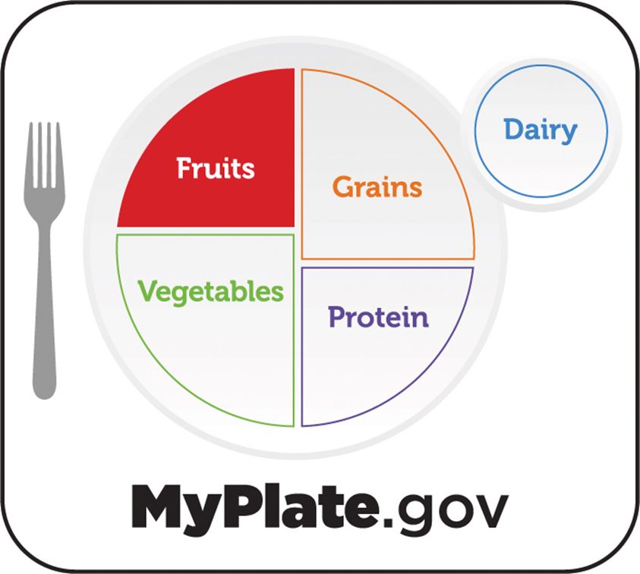
MyPlate Snack Plate
Notes:
Fruit

Slide 9
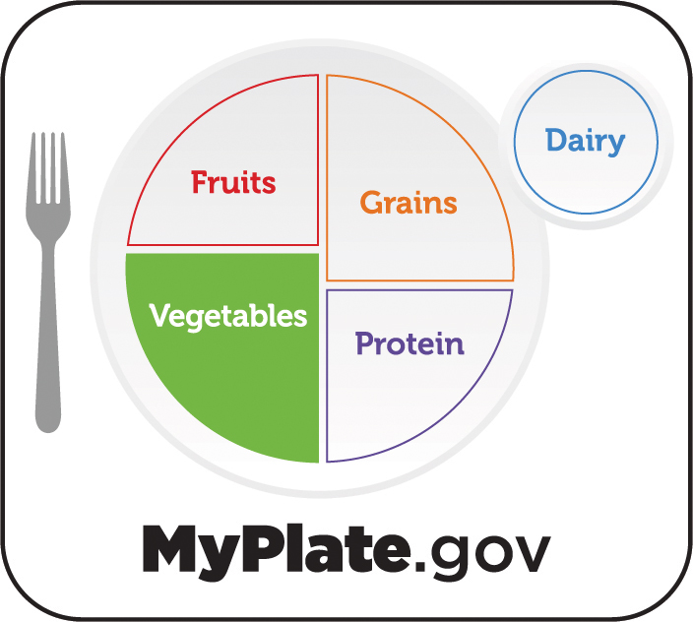
MyPlate Snack Plate
Notes:
Vegetables

Slide 10
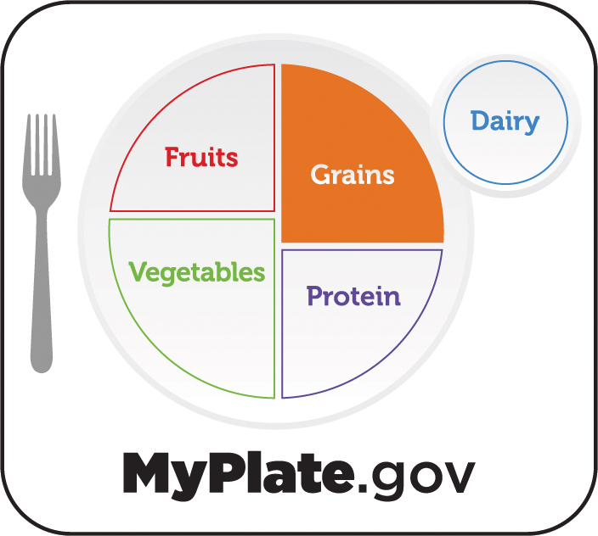
MyPlate Snack Plate
Notes:
Grains

Slide 11
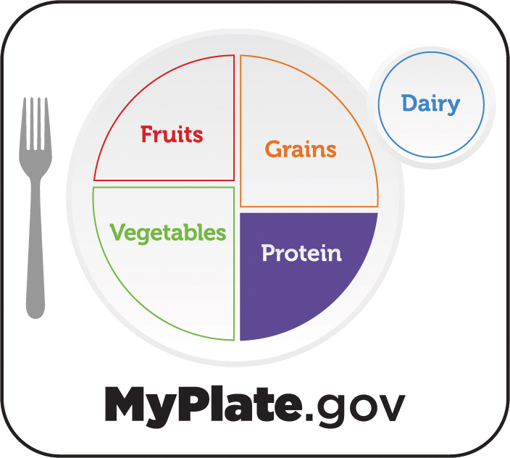
MyPlate Snack Plate
Notes:
Protein

Slide 12
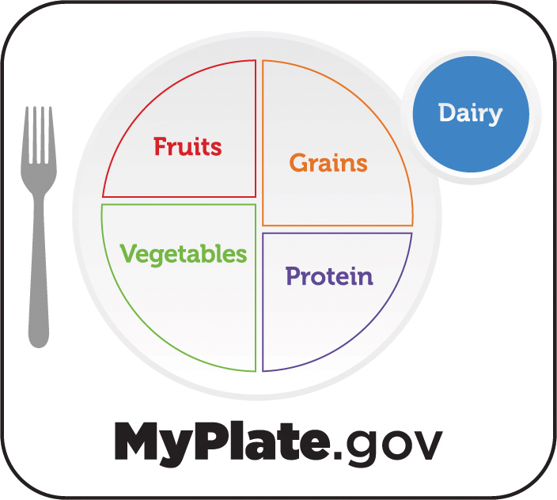
MyPlate Snack Plate
Notes:
And Dairy

Slide 13
MyPlate Snack Plate
Notes:
To make a complete MyPlate snack! OK, let’s get started!

