Slide 1
The Rutgers Culture of Health School Program
Lesson 6: Food Safety
RCHSP

Slide 2
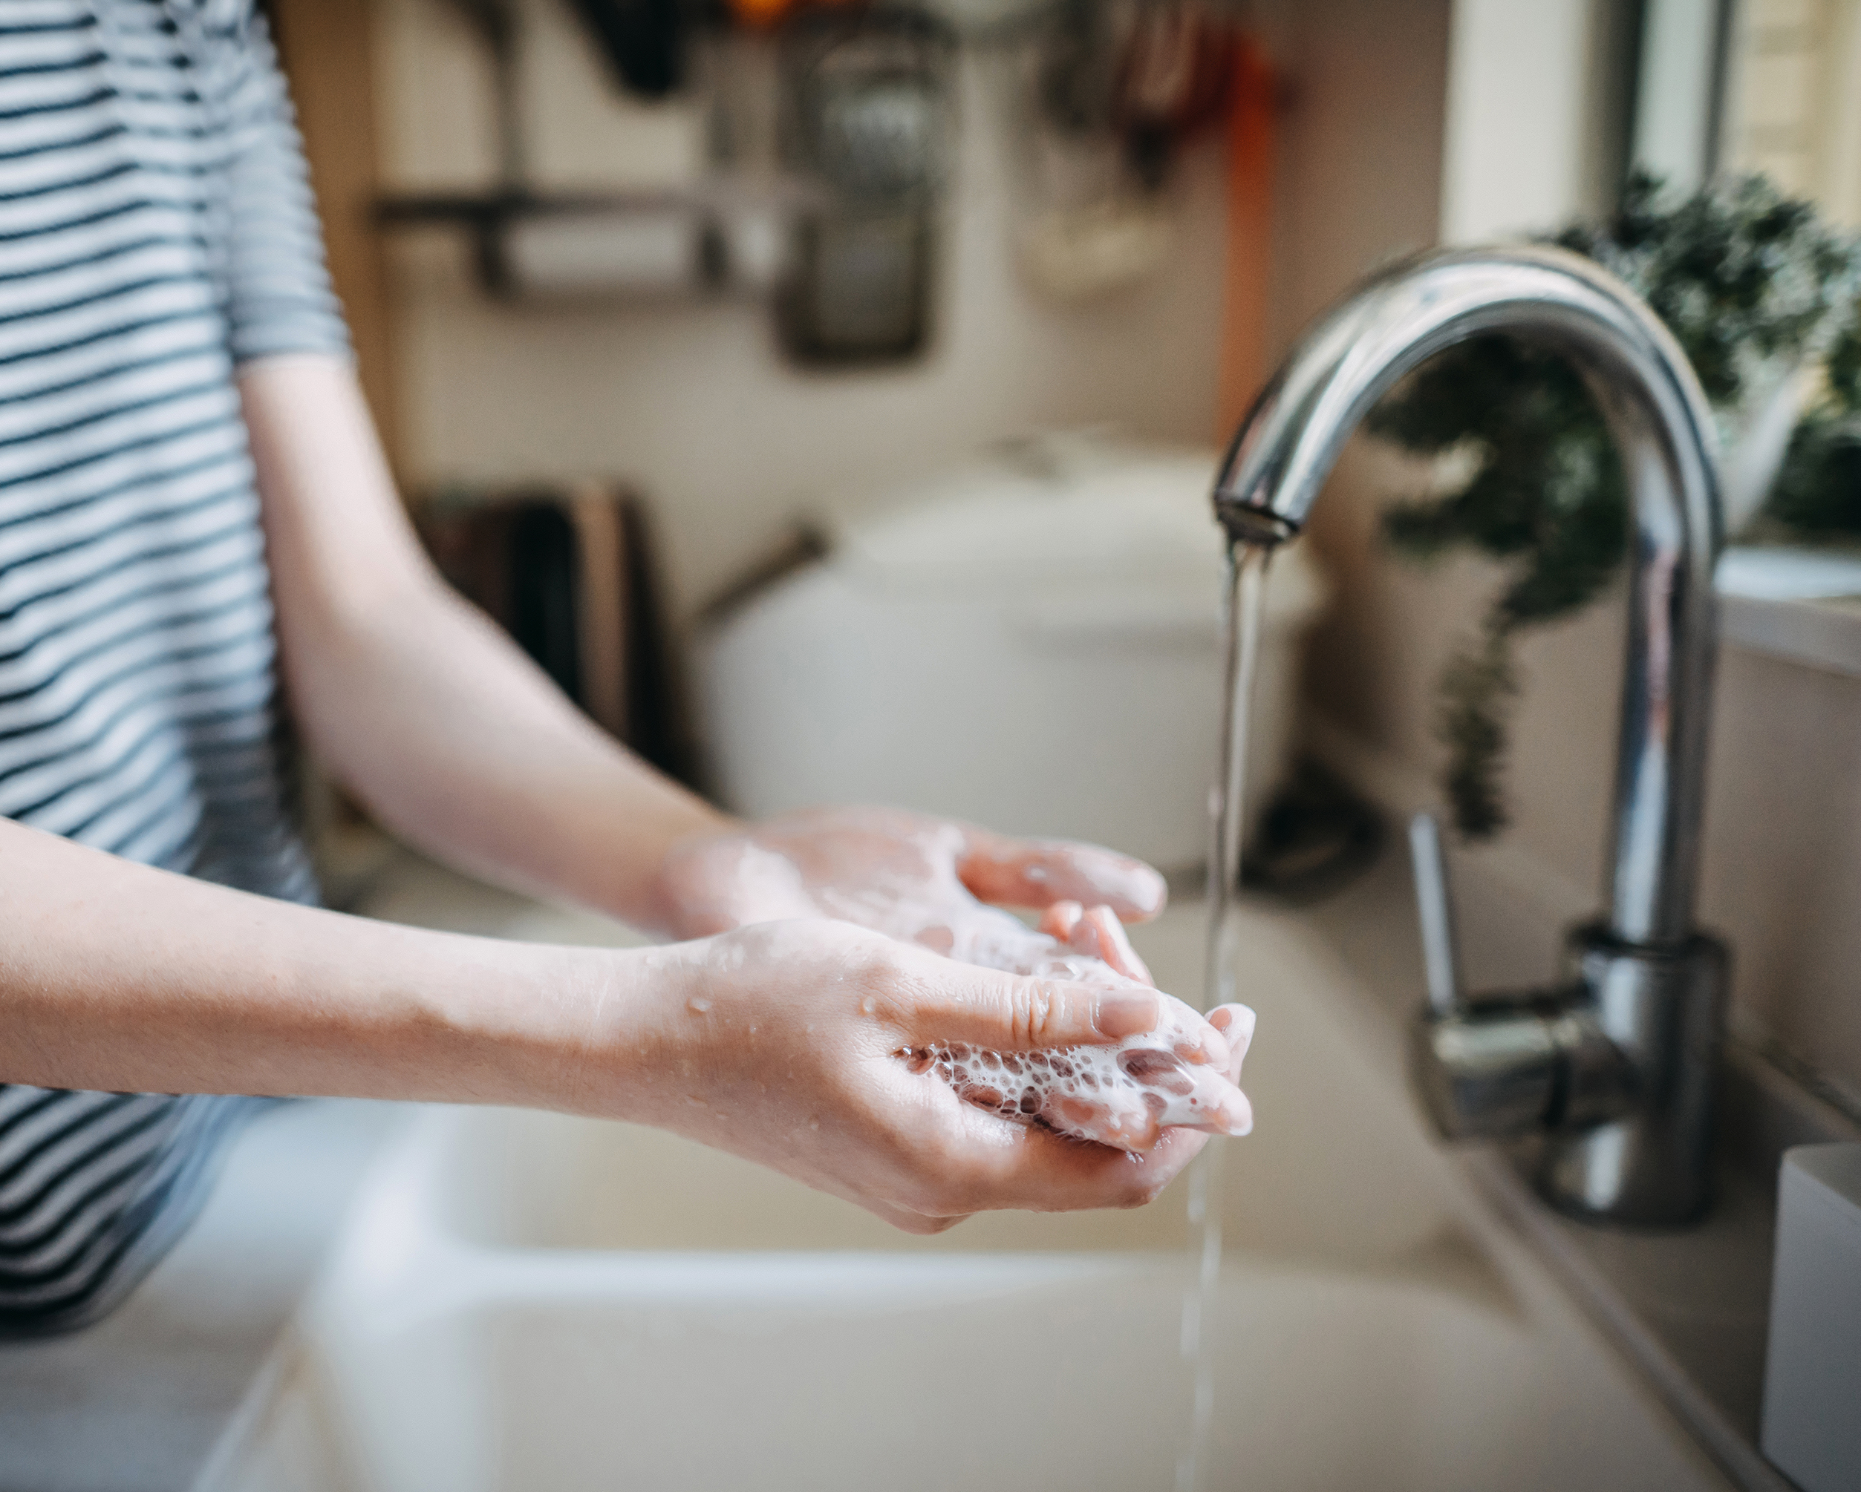
Our last class we learned:
About how to safely use common kitchen tools
Practiced knife skills
Today’s Schedule:
Introduction to Food Safety
Clean, Separate, Cook, Chill
Watch a Handwashing Fail & learn more with a Food Safety Video
Activity: GloGerm Handwashing
How clean are your hands?

Slide 3
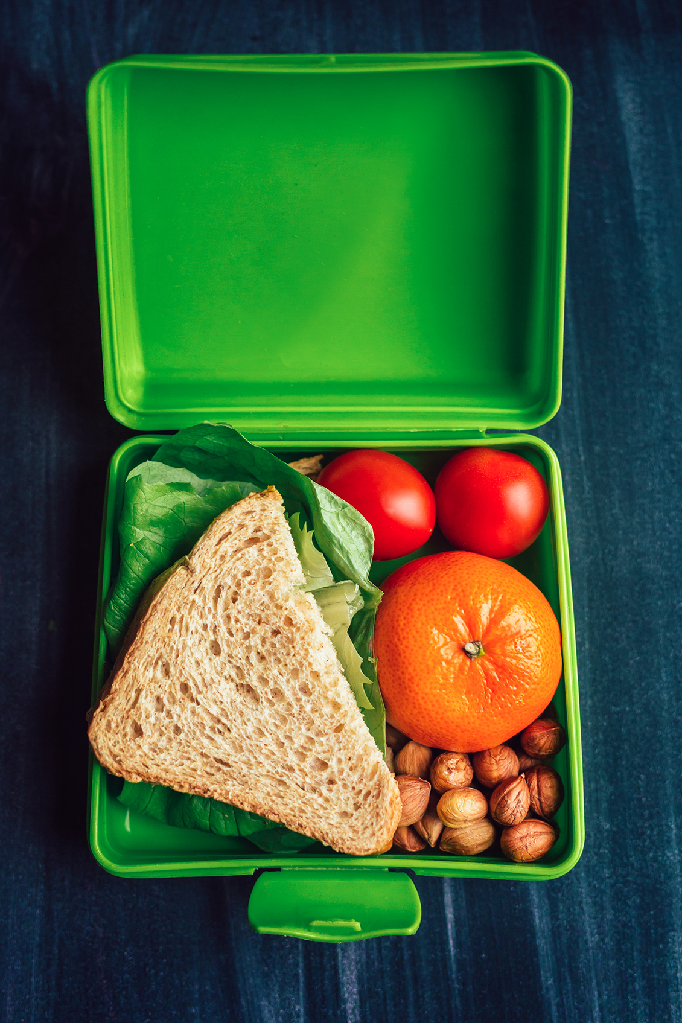
Food Safety
Proper food safety prevents foodborne illness.
There are 4 steps to food safety:
Clean
Separate
Cook
Chill
Let's see what not to do…

Slide 4
Let's Watch a Video about Kitchen Tools:
Handwashing Fail
Notes:
If video is not playing use this address: https://www.youtube.com/watch?v=iGg0hAZgZ1Q

Slide 5
Let's Watch a Video about Kitchen Tools:
Let’s Learn More about Food Safety
Notes:
https://youtu.be/8saUbDu4iwc

Slide 6
How well do you think you wash your hands?

Slide 7
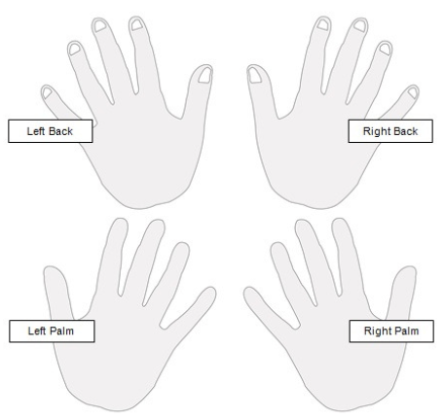
Glo Germ Handwashing Activity
Place a quarter-sized amount of Glo Germ in the palm of your hand.
Rub hands together to spread the “germs” to both hands.
Look under the UV light to see the germs
Now wash your hands using your normal hand washing routine.
Then use the UV light to check to see how clean your hands are.
Color in areas you missed on your worksheet.

Slide 8
CONTACT US!
SEND US YOUR ASSESSMENTS, FORMS, FEEDBACK, AND QUESTIONS

