Slide 1
The Rutgers Culture of Health School Program
Lesson 5: Kitchen Tools
RCHSP
Notes:
https://www.youtube.com/watch?v=iGg0hAZgZ1Q

Slide 2
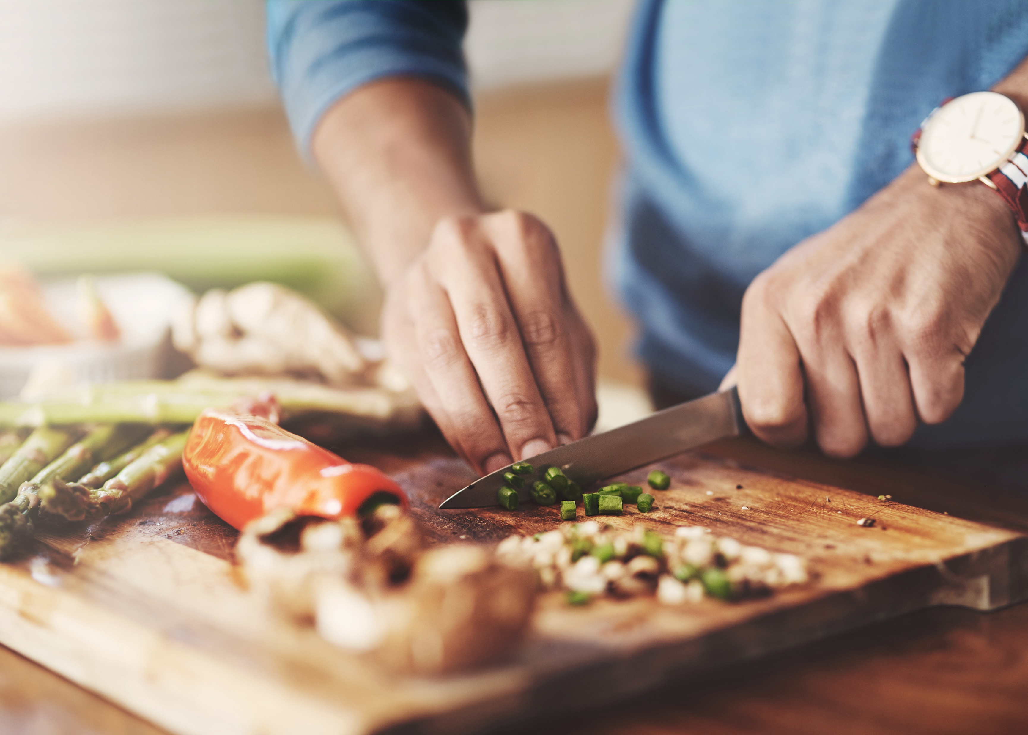
Our last class we learned:
How to read a nutrition facts label
Today’s Schedule:
Introduction to Kitchen Tools
Watch Kitchen Tools Video
Activity: Cutting a Cucumber Like a Pro/Cucumber Water
Practice knife skills

Slide 3
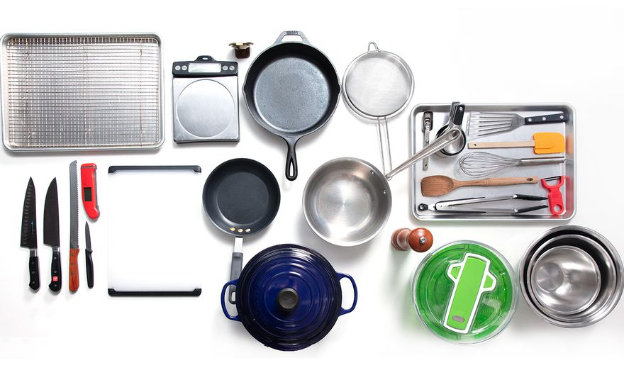
What are kitchen tools?
Notes:
The word kitchen tool refers to any item that we use to cook/prepare/and eat food, from smaller items like utensils (forks, spoons, knifes, whisks, spatulas) to kitchen equipment (like a microwave, oven, toaster, blender) or even the cookware we use to put our foods in like plates, bowls, pots, and pans.
I’m sure your house has lots of kitchen tools. But have you ever used them? Do you know how to use each safely? Today we are going to learn a little more about some common kitchen tools and and how to use each safely and effectively.

Slide 4
Let's Watch a Video about Kitchen Tools:
ç
Let's watch a video to learn more about kitchen tools
Notes:
If video is not playing use this address: https://www.youtube.com/watch?v=iGg0hAZgZ1Q

Slide 5
Why is knowing about kitchen tools helpful when we bake and cook?
Notes:
What are some of the ways fruits and vegetables add variety to our meals?

Slide 6
Do You Cut Like This?
ç

Slide 7
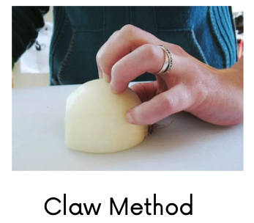
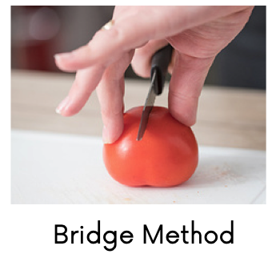
Let’s Practice Safe Knife Skills
Cutting a Cucumber Like a Pro
Clean and secure your cutting board
Rinse the cucumber in cold water.
Peel the cucumber (optional)
Practice using proper knife techniques to cut the cucumber:
Bear claw/Bridge method
Continue cutting by alternating between methods to make different cuts.

Slide 8
CONTACT US!
SEND US YOUR ASSESSMENTS, FORMS, FEEDBACK, AND QUESTIONS

