Slide 1







The Rutgers Culture of Health School Program
Lesson 4: Nutrition Facts Label
RCHSP

Slide 2


Our last class we learned:
Marketing techniques used to sell us unhealthy foods
How to make our own informed food choices
Today’s Schedule
Introduction to the Nutrition Facts Label
    What information does the label contain?
Watch Nutrition Facts Label Video
Make “Return to the Facts” Trail Mix
Figure Out the Facts Worksheet!

Slide 3
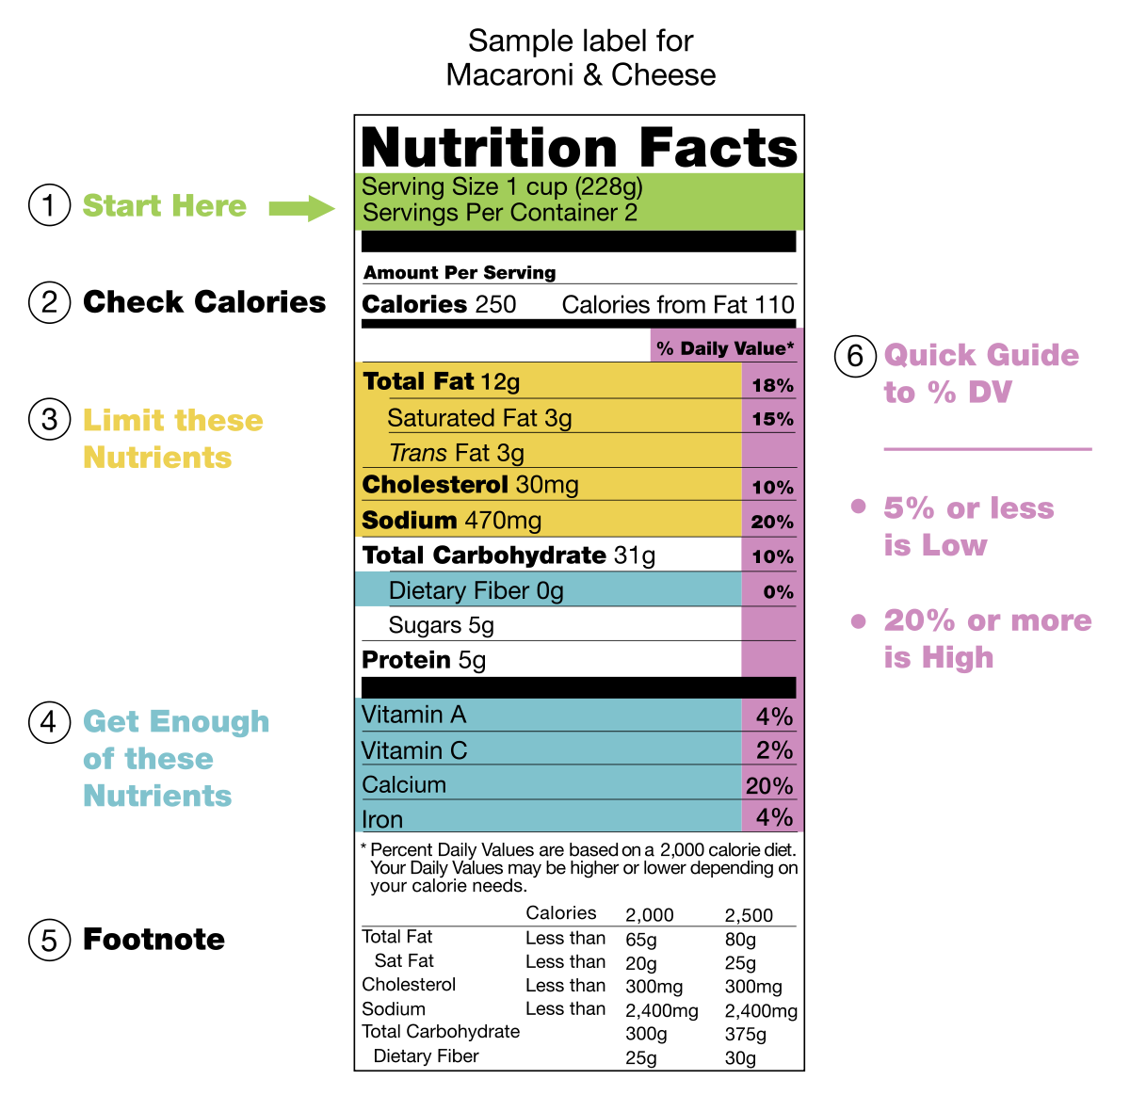
Nutrition Facts Label

Slide 4
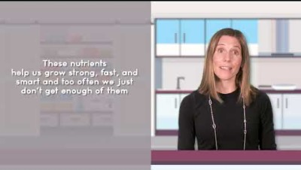

Notes:
https://youtu.be/63hrU-ewTU8

Slide 5
What is the first thing you look at on the Nutrition Facts Label?
Notes:
Serving Size… That’s how you know how much the values on the nutrition fact label for that one serving

Slide 6
What nutrients do we want to be high on our nutrition facts labels?
Notes:
Dietary Fiber, Vitamin D, Calcium, Iron, and Potassium

Slide 7
What nutrients do we want to be lower on our nutrition facts labels?
Notes:
Saturated Fat, Sodium and added sugar

Slide 8
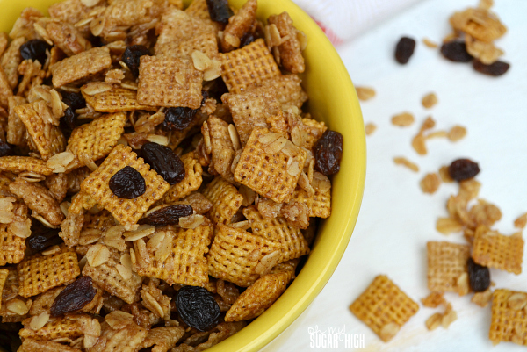
Return to the Facts: Trail Mix!
Ingredients:
1/4 cup Whole Wheat Chex
1/8 cup (2 Tablespoons) Raisins
1 Tablespoon Semi-sweet Chocolate Chips
1 Tablespoon Sunflower seeds
½ oz (14 g) Unsalted Pretzels
Instructions:
Measure each ingredient into bag.
Mix and enjoy!

Slide 9
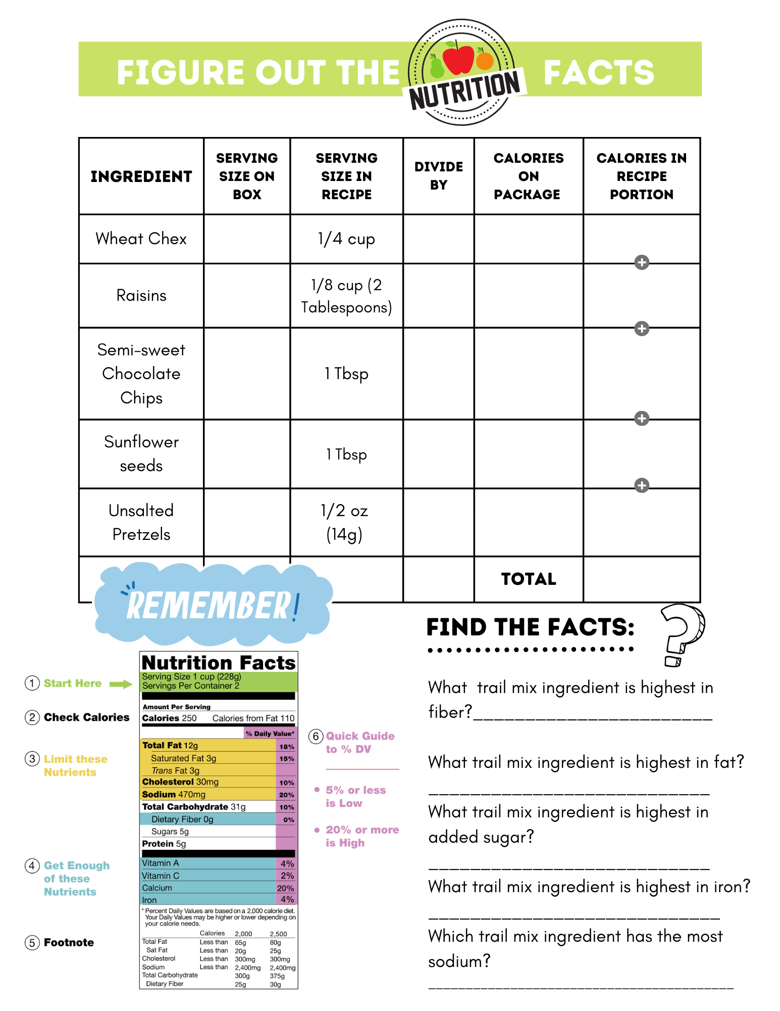
Let’s Find the Facts!
Work to calculate the calories in your trail mix.

Slide 10
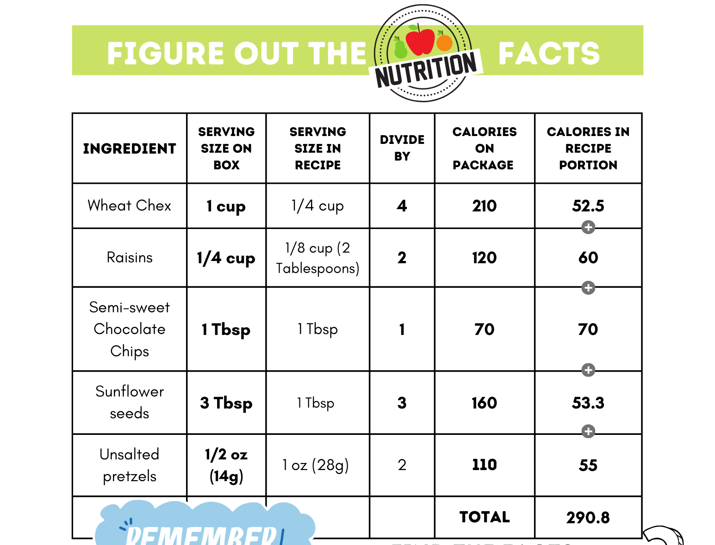
Did you get it right?

Slide 11
Did you get it right?

Slide 12

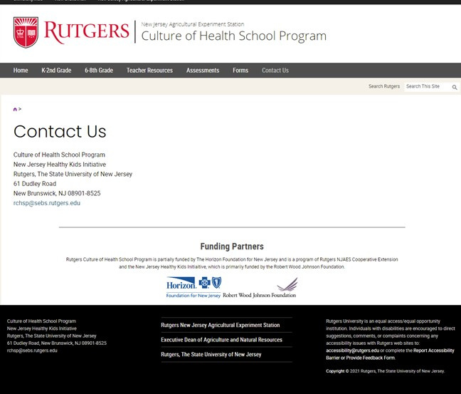

CONTACT US!
SEND US YOUR ASSESSMENTS, FORMS, FEEDBACK, AND QUESTIONS

