Slide 1
Get Real.
Eat Real.
Rutgers Culture of Health School Program

Slide 2
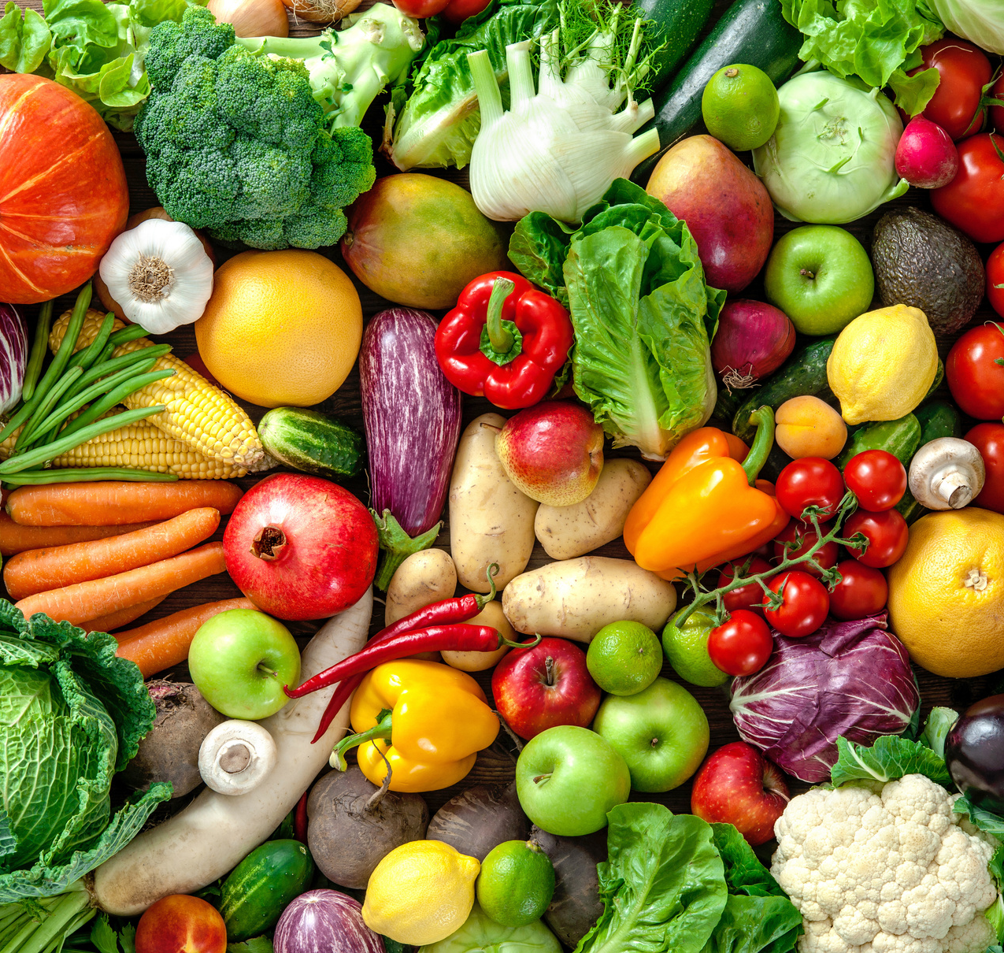
Our last class we learned:
About MyPlate
½ our plate should be plants (veggies/fruit)
Today’s Schedule
Intro to "Getting Real"
What are Whole Foods? What are Processed Foods?
Watch a Video to Learn More
Divide into groups
Make Your Own Snack
Can we make popcorn taste like Dortios?
Group Competition
Who can make the best whole food plate?

Slide 3
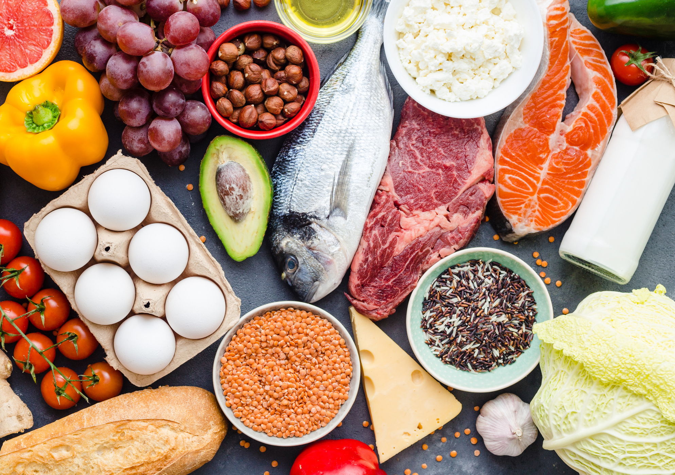
What do you think of?

Slide 4
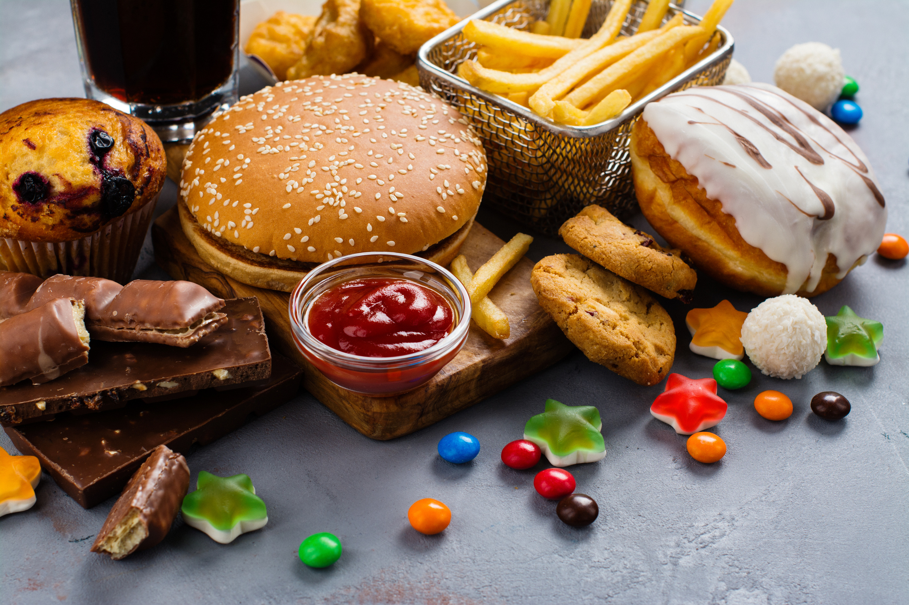
What do you think of?

Slide 6
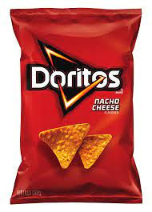
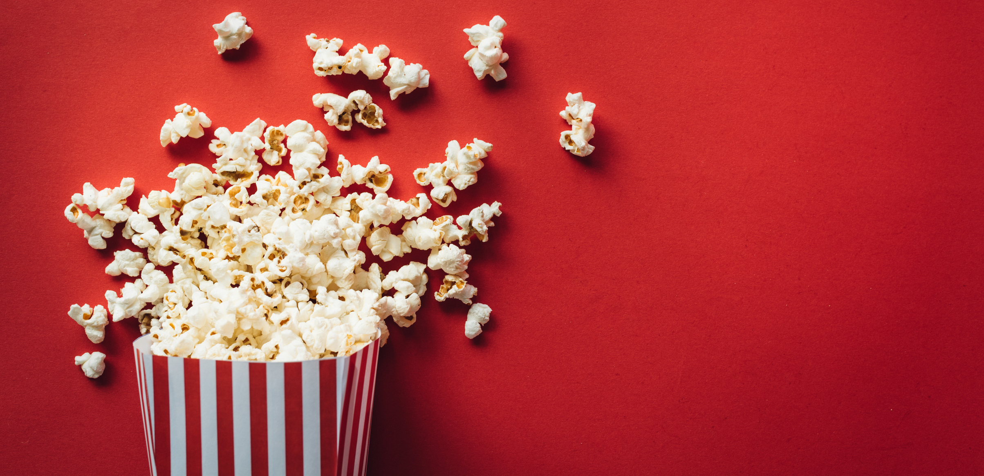
"Doritos Popcorn"
Nacho Cheese
Recipe:
2 Tbsp nutritional yeast
1/4 tsp garlic powder
1/4 tsp onion powder
1/4 tsp cumin
1/4 tsp paprika
1/4 tsp chili poweder
1/4 tsp salt

Slide 7
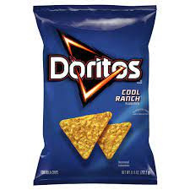
"Doritos Popcorn"
Cool Ranch
Recipe:
1/2 tsp dried dill
1/2 tsp dried chives
1/2 tsp garlic powder
1/2 tsp onion powder
1/4 tsp salt
1/4 tsp pepper
Mix

Slide 8
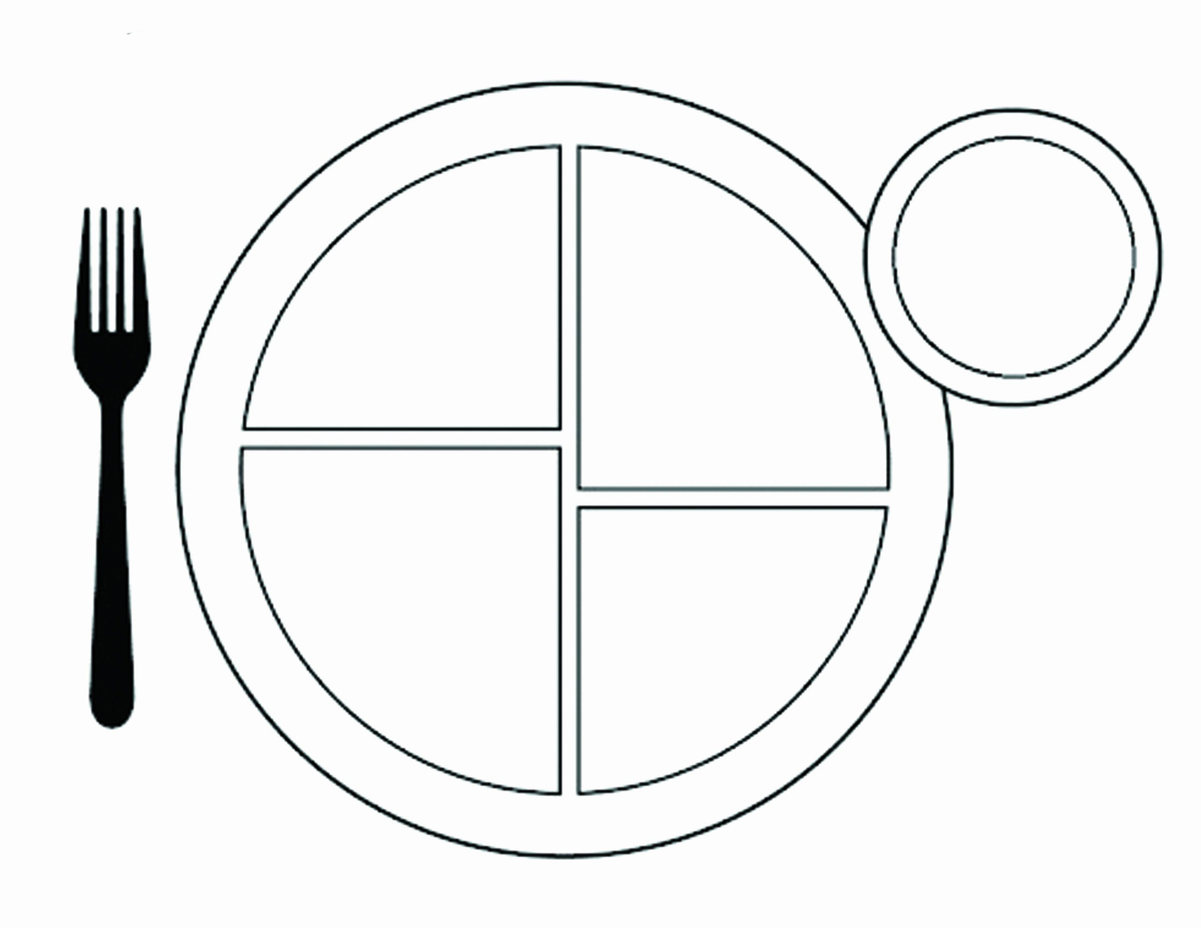
Design a "Real Meal" Competition
who will win?

Slide 12
Design a "Real Meal" Competition
You will be judged on
The quality of your food choices - unprocessed & whole
How much your plate matches MyPlate guidelines (all 5 groups)
Creativity, Labeling, & Drawings

Slide 13
Thank you for participating!
See you next week for
Lesson 3: Food Advertising
RCHSP

Slide 14
Thank You!
Start eating more “real” foods today! Contact us with questions!

